Slide 1

Customer segmentation

Slide 2

Why?
Understand our customers’ preferences
Create customized event for target cluster
Attract potential customers

Slide 3

How?
Data collection
Natural language processing
Classification modelling

Slide 4
Part 1 : Data collection

Slide 5
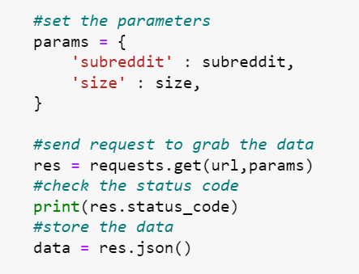
Data collection
Source: Reddit
Use the request library for data gathering

Slide 6
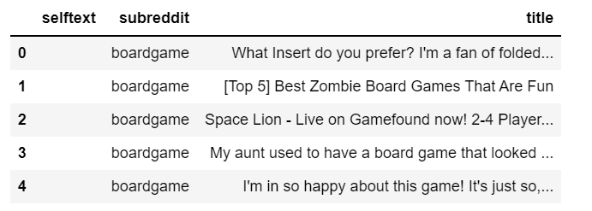
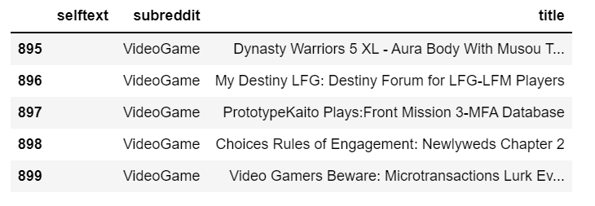

Slide 7
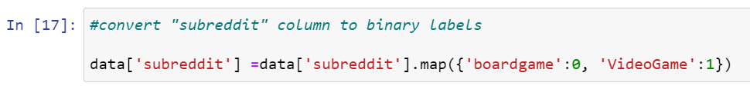
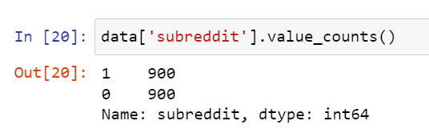
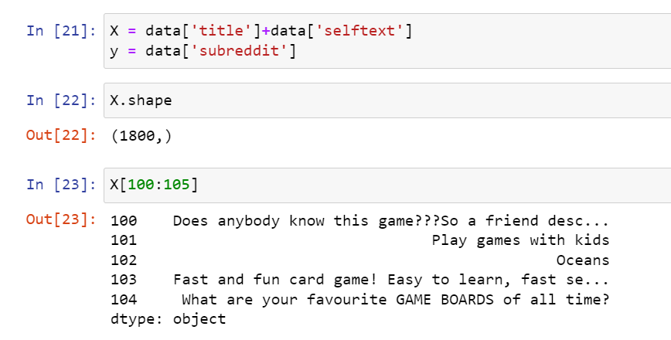
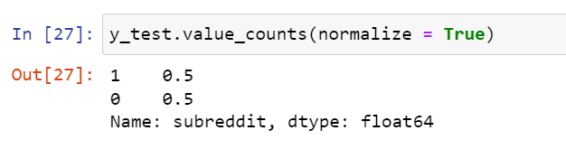
Data preparation
Convert “subreddit” column to binary labels
3. Checking
2. Combine the texts into one column

Slide 8
Part 2 : Natural Language Processing

Slide 9
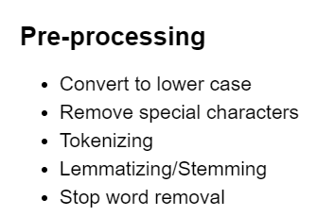
Natural Language Processing
CountVectorizer
TfidfVectorizer

Slide 10
Part 3 : Classification Model

Slide 11
Classification Model
Random Forest
Logistic Regression
Naïve bayes

Slide 12
Accuracy
 | Random Forest | Logistic Regression | Naïve bayes
CountVectorizer | 0.897 | 0.905 | 0.881
TfidfVectorizer | 0.908 | 0.905 | 0.875

Slide 13
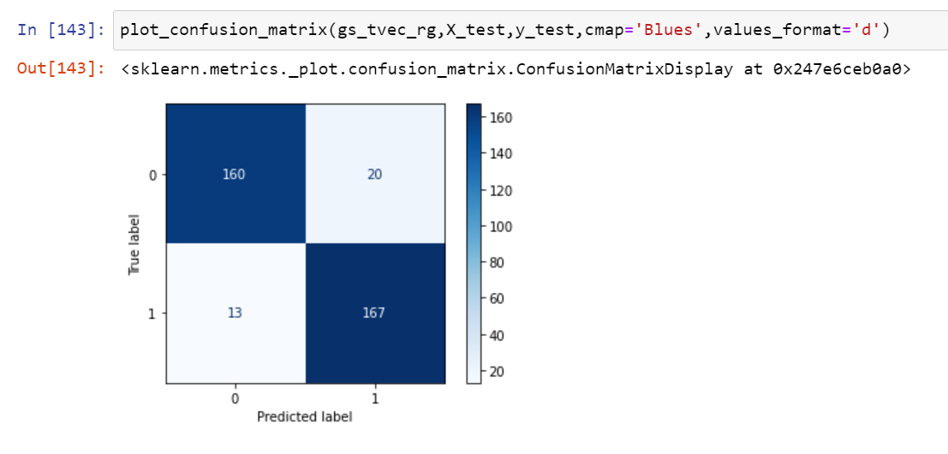
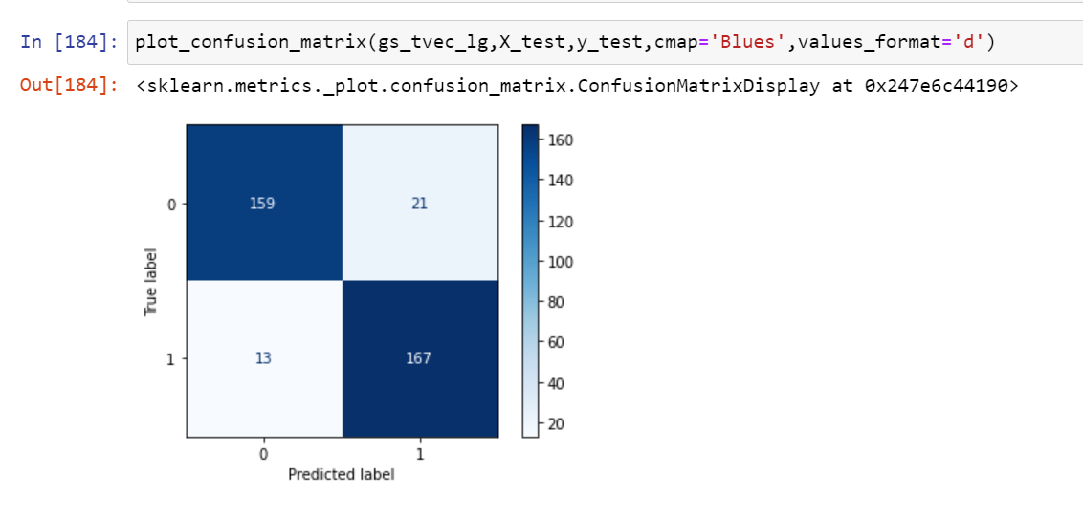
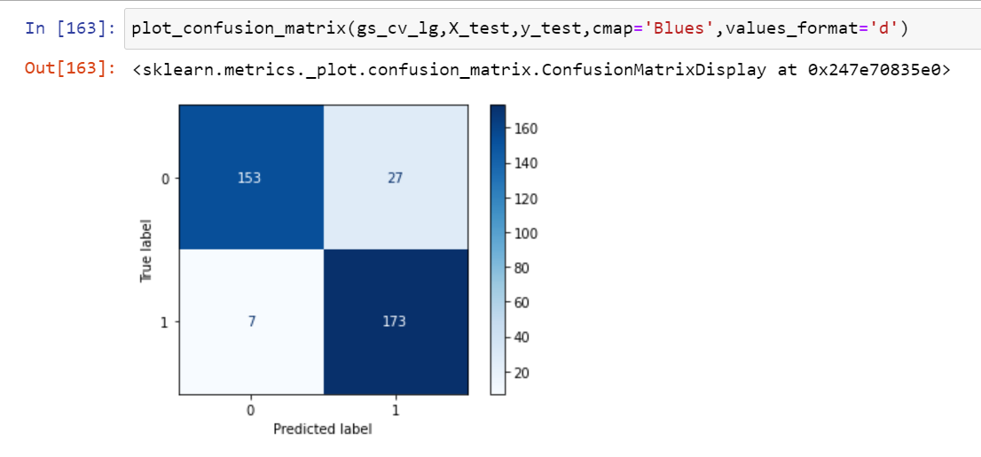
0 – Boardgame; 1 - Videogame
TfidfVectorizer+Random Forest
TfidfVectorizer+Logistic Regression
CountVectorizer+Logistic Regression
good at predicting videogame

Slide 14
Conclusion
NLP: TfidfVectorizer
Model: Random Forest, Logistic Regression

Slide 15
What can we do next?
Increase the number of sample for model training
Add more subreddits to decide the next marketing activity

